Slide 1



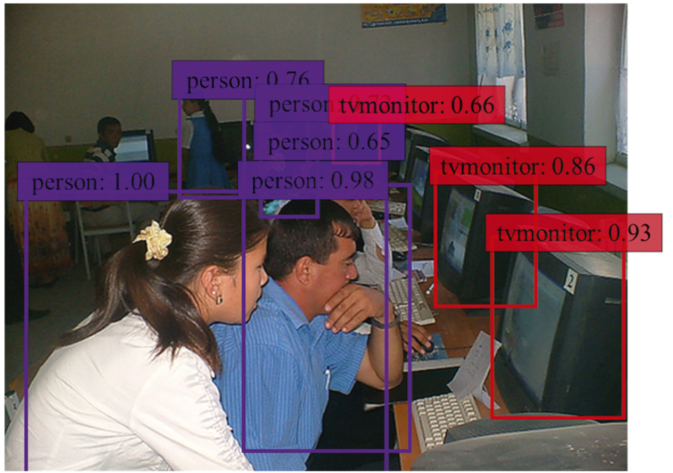
Object detection using single shot detector(SSD)
By: -
Komal Sharma(12102040501039)
Naresh Kumar(12102040501045)
Guided by: - Dr. Kinjal Joshi

Slide 2
Project outline
Problem statement
Objectives
Technology stack
Flowchart
Applications
Challenges

Slide 3

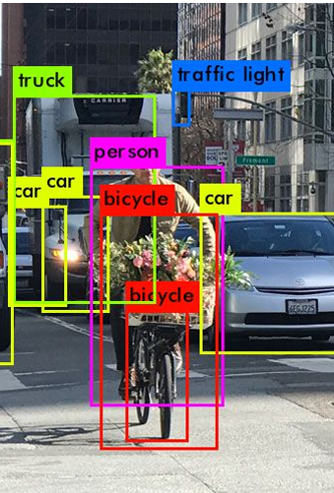

Problem statement
Design and implement an object detection system that can identify and locate objects within images or video frames in real-time.
The Single Shot MultiBox Detector (SSD) is an object detection algorithm that has been improved in various ways to enhance its performance.
Object detection using SSD typically involves addressing its limitations and improving its accuracy, speed, and ability to detect small objects.
The system should use the SSD algorithm, which stands out for its ability to swiftly and accurately detect and locate objects in real-time.

Slide 4
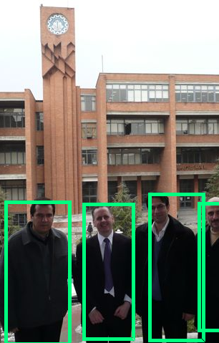
objectives
Identify Objects: The system should be capable of identifying different objects within images or video frames.
Locate Objects: After identification, the system should accurately locate these objects within the images or video frames.
Real-Time Detection: The system should perform these tasks in real-time, making it suitable for applications that require immediate feedback.
Handle Different Sizes and Shapes: The system should effectively handle objects of varying sizes and shapes.
Maintain High Accuracy: While improving detection speed, the system should maintain high accuracy in object detection.

Slide 5


Technology stack
Web Camera
Python with latest version
Library used is:
CV2(OpenCV)
OpenCV (Open-Source Computer Vision Library) is an open-source computer vision and machine learning software library.
OpenCV provides a real-time optimized Computer Vision library.

Slide 6
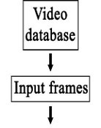
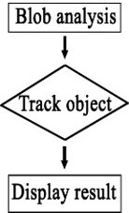

flowchart

Slide 7
What is blob analysis?
BLOB stands for a “Binary Large Object,” a data type that stores binary data.
The method of analyzing an image that has undergone binarization processing is called "blob analysis".
Binarization is a process of conversion of grayscale images into binary images, where pixels are represented as either black or white.

Slide 8
Dataset
The dataset comprises sourced from dataset available on Kaggle, namely the Object Detection Dataset.
The distribution of images across the 10,000 images is as follows:
Person: 3,000 images
Car: 2,500 images
Bicycle: 1,500 images
Dog: 1,000 images
Cat: 800 images
Bus: 700 images
Truck: 600 images
Traffic Light: 400 images
Stop Sign: 300 images
Motorcycle: 200 images

Slide 9
Data Preprocessing
Since the model is pre-trained, there is no need of data Preprocessing.

Slide 10
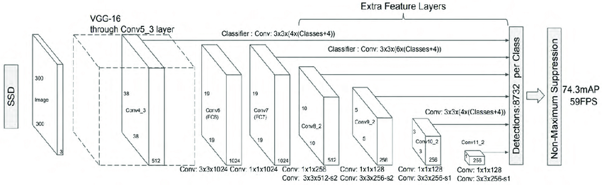
Architecture of SSD

Slide 11
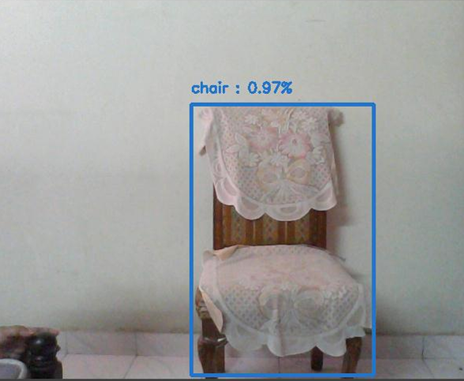
Results:
Screenshot 1:
Figure: Objects detected using webcam

Slide 12
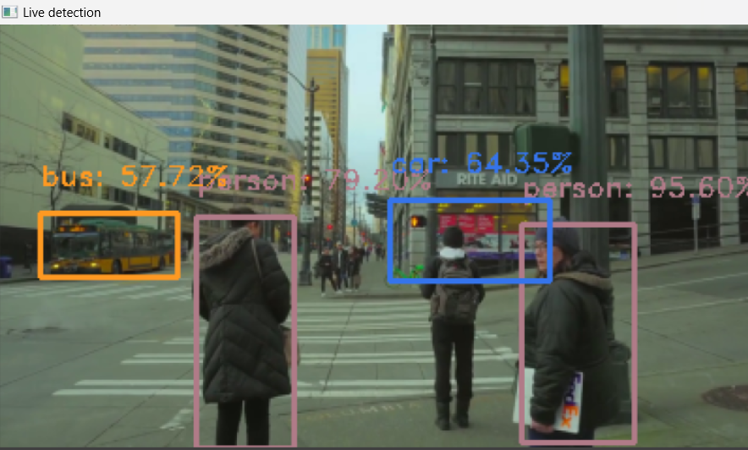
Results:
Screenshot 2:
Figure: Objects detected using Video

Slide 13
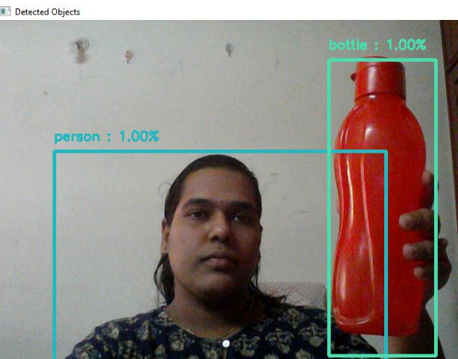
Results:
Screenshot 3:
Figure: Objects detected using Webcam

Slide 14
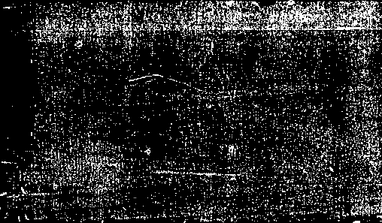

Applications of SSD
Autonomous driving
Video Surveillance
Object Tracking in Videos
Real-Time Image Analysis
Drones and Aerial Imaging
Human-Computer Interaction
Object recognition in robotics.

Slide 15
challenges
Variations in Object Appearance: Objects can appear differently due to variations in lighting, orientation, and occlusion, making it difficult to detect them accurately.
Cluttered or Textured Background: Objects of interest may blend into the background, making them hard to identify.
Intra-Class Variation: Objects of the same class can have significant variations in appearance, making it challenging to detect them accurately.
Real-Time Performance: Real-time object detection requires high-speed processing, which can be challenging to achieve while maintaining accuracy.
Hardware Limitations: Object detection models require significant computational resources, which can be limited by the available hardware.

Slide 16
references
J. Redmon, S.Divvala, R.Girshick, A. Farhadi, You only look once: Unified, real-time object detection.
A. Krizhevsky, I. Sutskever, G.E. Hinton, ImageNet classification with deep convolutional neural networks.
Advances in neural information processing systems. H. Jiang, E. Learned-Miller, Face detection with the faster.
https://arxiv.org/abs/1711.06897v3
https://www.kaggle.com/code/shivamanhar/object-detection-in-mobilenet-ssd
https://link.springer.com/chapter/10.1007/978-3-319-46448-0_2
https://ieeexplore.ieee.org/document/8578572
https://www.visco-tech.com/english/technical/direction-presence/blob/

Slide 17
Thank you

